Slide 1

State of the Circuit
J. Thomas McGrady
Chief Judge
Sixth Judicial Circuit
November 2, 2012

Slide 2

Today’s Topics:
Technology initiatives in the Sixth Circuit
Judicial Consolidation and Facilities Planning
How you can support the judiciary

Slide 3
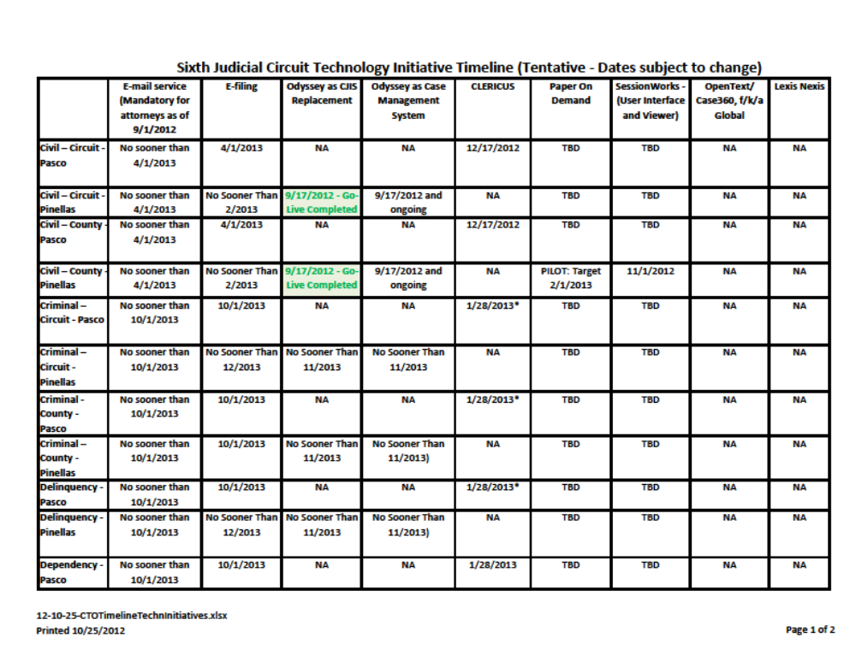
Sixth Judicial Circuit Technology Initiative Timeline and Glossary

Slide 4
E-Service between attorneys
Effective September 1, 2012, in the civil, probate, small claims, family law, and appellate divisions, attorneys must serve pleadings and documents on other attorneys by e-mail in accordance with Rule of Judicial Administration 2.516.
See instructional material from The Florida Bar: http://www.floridabar.org/TFB/TFBResources.nsf/Attachments/776A8454354EDA0185257A4C005FBDE5/$FILE/Mandatory%20Service%20by%20Email%20Education%20(E-Slides-v1.1).pdf?OpenElement

Slide 5

E-Service to and from the Courts
You should not serve pleadings and documents on the courts in the Sixth Judicial Circuit (Pasco and Pinellas Counties) by email. This includes judges, magistrates, hearing officers and their assistants, and any other court staff.
The Sixth Judicial Circuit (Pasco and Pinellas Counties) will not be serving orders by email. The Circuit does not currently have the capacity to do so. It is anticipated that the Justice Consolidated Case Management System in Pinellas County and CLERICUS in Pasco County will have the capacity to serve notice at a later date. Until that time, service of orders in the Sixth Judicial Circuit will continue to be by U.S. Mail.

Slide 6
E-Portal
The 67 clerks are in various stages of readiness with regard to accepting pleadings via the portal
In the Sixth Circuit:
  Pinellas - Pilot project underway; expansion to all Probate cases imminent
  Pasco – No current approved plan to utilize the Portal. Currently using Lexis for e-filing in Probate.
Single Statewide Login and Web Access
Will support electronic payments and transaction logs
Will provide notifications and service
Validation by Portal and by Local Clerk

Slide 7

E-filing
E-filing is currently in use in the Probate, Guardianship, and Mental Health division in Pasco County.
Administrative Order SC09-30 sets forth the standards for e-access that the Clerks of Court must follow when implementing these systems.
These standards will be followed as the Sixth Circuit transitions to e-filing in all court divisions.

Slide 8
E-filing, continued
The Supreme Court recently issued an opinion (SC10-2101 Second Corrected) on e-filing which sets forth the following schedule:
April 1, 2013 for civil, probate, small claims, and family law
October 1, 2013 for criminal, traffic, delinquency and dependency
Note: Our implementation may differ slightly because of the transition to the new Odyssey Justice CCMS system.

Slide 9

Justice CCMS (Consolidated Case Management System) successfully launched on September 17, 2012 and replaces the existing legacy system (CJIS) for civil, family, and small claims cases.
It is a single application that will provide case management, e-filing, imaging, and workflow
Created by a company called Tyler, the product used is called Odyssey
During transition, users will need to check cxisting CJIS and Justice CCMS for full information on a person
Notes:
The CJIS System is an IBM mainframe system containing over 2,000 individual programs. This outdated technology is becoming more and more difficult to maintain.

Slide 10

Public User Logon
Can be accessed from
  Sixth Judicial Circuit Website
    Public Records
    Attorneys, Search Court Records, Pinellas County
  Pinellas Clerk of the Court Website
    Search Records
  Pinellas County Government Website
    Public Records

Slide 11
CLERICUS
Case maintenance system created by the Clerks’ statewide association, now FCCC (Florida Clerks of Court and Comptrollers)
To be used by 37 Clerks statewide, including Pasco County
Other nearby counties who plan to use CLERICUS are Manatee and Hernando

Slide 12

Paper on Demand
A paper on demand pilot project is currently in development in all five (5) county civil sections in Pinellas County, initially excluding small claims.
The tentative target date to launch the pilot project is February 2013.
Notes:
The Clerk is also receiving traffic citations electronically.

Slide 13
Judicial Facilities Consolidation Project
Construct an annex at the Criminal Justice Center (CJC)
Consolidate traffic courts to CJC in the annex
Move Unified Family Court (UFC) judges, staff and related functions to the annex
Move family and guardianship magistrates and related staff to 545 Judicial Building
Move remaining support staff to 545 Judicial Building or to the CJC annex
Vacate court-assigned areas in 501 Building

Slide 14

Things that need to happen first
Parking structure at CJC – design firm has been selected
Expanded entry at CJC
Construction of annex at CJC

Slide 15
Primary benefits of consolidation to the judiciary
Creates economies of scale for judiciary by co-locating judges and staff for purposes of coverage
Eliminates the county’s obligation to house court employees in the 501 building, creating cost savings in operating expenses and generating capital revenue through the sale of the building

Slide 16

St. Petersburg Judicial Tower Renovations
The renovations to the 5th floor of the St. Petersburg Judicial Building (former Law Library space) are complete.
The three (3) county civil judges assigned to St. Petersburg were moved to the new space last week.
There will be some re-assignment of offices in early January.

Slide 17
Central Court Facility in Pasco
September 2012 - Design plans were drafted and submitted to all stakeholders for review and comments
November 2012 - Plans were submitted to the BOCC for approval
The County has $7M available for the project; the County Administrator is looking into the bond process for additional funds to meet the projected $29M construction costs

